Slide 1
Maersk RFID Pilot Solution for Levi’s
By Maersk Global SCM 2019-08-06

Slide 2
RFID Handheld Scanning: Objective: Track packing accuracy down to SKU level and provide visibility to Levi’s for RFID tag (number of pieces) under each PO/SKU and inside each carton
Scan solution:
Equipment applied in the pilot will be Zebra MC3390R
Dedicated RFID scanning area will be set up to ensure scan data integrity
All cartons of selected PO will be removed from pallets to scanning area for individual scanning
Maersk will perform RFID scan per carton, and manually record PO number and label number showing in outer carton
Cartons will be restored on pallets after scanning and moved to storage bay
Maersk will validate accuracy of pieces per PO per carton against pre-ASN, and follow up with vendors to resolve exception
Maersk will send RFID visibility report to Levi’s through email
Levi’s Pre-ASN |  |  |  | Maersk CFS RFID Tracking |  |  | Discrepancy
PO# | SKU# | Label # | Quantity | PO # | Label # | Quantity
1000285581 | 72334-0329 | 96954012 | 14 | 1000285581 | 96954012 | 14
1000285581 | 72334-0329 | 96954013 | 14 | 1000285581 | 96954013 | 12 | Mismatch
1000285581 | 72334-0329 | 96954014 | 14 | 1000285581 | 96954014 | 14
1000285581 | 72334-0329 | 96954015 | 14 | 1000285581 | 96954015 | 14
1000285581 | 72334-0330 | 96954016 | 12 | 1000285581 | 96954016 | 12
1000285581 | 72334-0330 | 96954017 | 12 | 1000285581 | 96954017 | 12
1000285581 | 72334-0330 | 96954018 | 12 | 1000285581 | 96954018 | 12
1000285581 | 72334-0330 | 96954019 | 12 | 1000285581 | 96954019 | 14 | Mismatch
1000285582 | 72334-0331 | 96954020 | 14 | 1000285582 | 96954020 | 14
1000285582 | 72334-0331 | 96954021 | 14 | 1000285582 | 96954021 | 14
1000285582 | 72334-0331 | 96954022 | 14 | 1000285582 | 96954022 | 14
Notes:
QC control was actually taking place at destination where instant replenishment is impossible, airfreight can’t be avoided

Slide 3

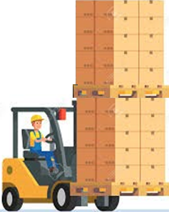

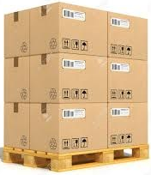

High Level Physical Cargo Handling Flow - Handheld
Put-away rest cargo to storage
Inbound
RFID Scanning Area
Gate-in
Unload & cargo receive
Move cartons to RFID scanning area
Carton scan
Put-away cartons to storage
Cargo Storage
Outbound
Gate-out
Container stuffing
Handling out to loading bay
Note: RFID tag is sensitive and minimum distance between scanning groups is determined based on equipment type. Maersk’s testing with one of the equipment providers shows optimal distance as to be 1 meter.
Notes:
QC control was actually taking place at destination where instant replenishment is impossible, airfreight can’t be avoided

Slide 4
Thank You!

